Slide 1
KinecTECH
“Fun fitness based on REAL real-time data”

Slide 2
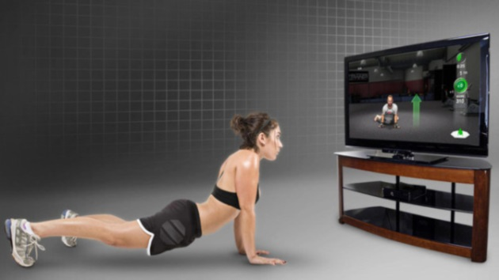
Real-time Difficulty Adjustment → MORE FUN
KinecTECH is an emerging health video game company
Goal: Design games that respond to your TRUE level of fitness

Slide 3
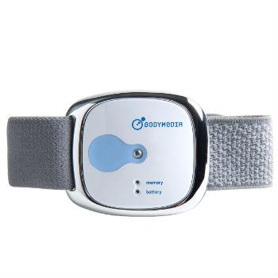
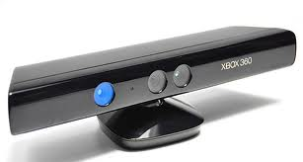
What does that mean?!
Our games leverage today’s most advanced kinectic and health biometric technology - in real time.
In short… WE HACKED and COMBINED:
XBox Kinect
Bodymedia Link

Slide 4
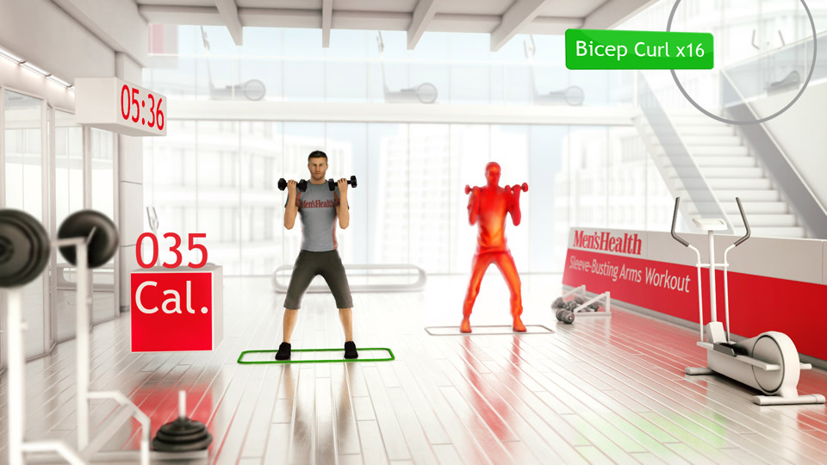
Today’s games only approximate YOUR results
Age + Weight + Activity Type + Duration = MY HEART RATE??

Slide 5


They’re both jumping. Who is really pushing their body?
How should the game progress?

Slide 6
Biometric Health Goal Setting
Player 1
Player 2
Name: Mary
Name: John
Age: 32
Age: 32
Workout Length: 1 hour
Workout Length: 1 hour
Goal Calories Burn: 1200
Goal Calories Burn: 1200
Rep Count: 1000
Rep Count: 1000

Slide 7
Activity Dashboard
Mary’s Activity Result
John’s Activity Result
1200
1200
Calories Goal:
Calories Burned:
Calories Goal:
Calories Burned:
400
7.3%
600
10%
Rep Goal:
Rep Count:
Perfection%:
1000
Rep Goal:
Rep Count:
Perfection%:
1000
600
10%
800
8%
60
10%
80
10%
Average Pump:
Max Pump:
150
5%
Average Pump:
Max Pump:
160
7%
170
2%
180
3%

Slide 8


Workout Summary
Mary’s Summary
John’s Summary
Level 3 to 2
Level 3 to 8

Slide 9
Traditional v. KinecTECH game-play

Slide 10
DEMO TIME!
MOTION + HEALTH BIO
=
REAL-TIME FEEDBACK!

Slide 11
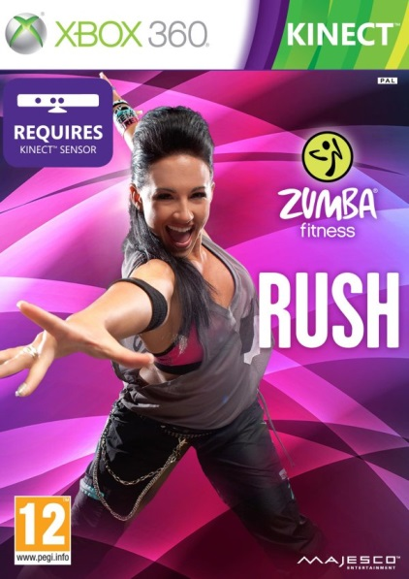
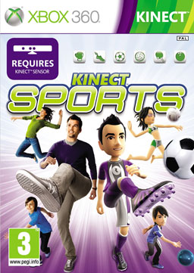
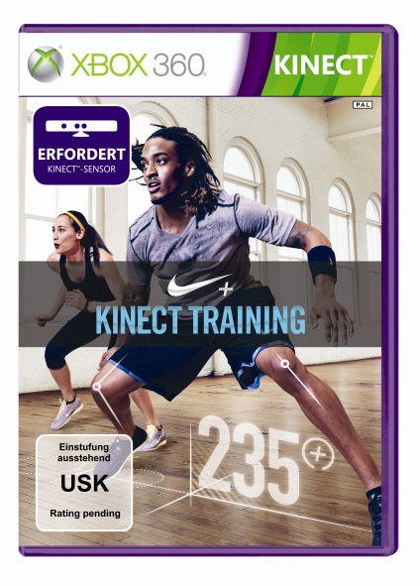
The Fitness Game market is BIG!
2.11 million
20.39 million
Units Sold
0.1 million
5.64 million

Slide 12

KinecTECH BENEFITS:
More encouraging (for the Unfit)
More challenging (for the Fit)
More fun! (for Everyone)
More video game sales! (for Us!)

Slide 13


HACK BONUS: We’ve democratized the Kinect!
Who can leverage the Kinect after Hack-Fit Boston?
EVERYONE!... COME SEE US TO USE OR HACK!
Optimize Performance
Physical Therapy

Slide 14
QUESTIONS?

